Slide 1


Network Layer All about routing
SE3331-1 (2022 Fall)
IPADS, Shanghai Jiao Tong University
https://www.sjtu.edu.cn
Credits to Katrina LaCurts, MIT

Slide 2
Review: OSI, TCP/IP & Protocol Stack
7th Application Layer
Application Layer
HTTP
SMTP
POP3
FTP
…
End-to-end Layer
6th Presentation Layer
5th Session Layer
4th Transport Layer
Transport Layer
TCP
UDP
3th Network Layer
Network Layer
IP
Network Layer
ICMP
2nd Link Layer
Link Layer
ARP & RARP
Ethernet
PPP
…
Link Layer
1st Physical Layer
WiFi
Fiber
TD-LTE
FDD
…
OSI
TCP/IP
CSE

Slide 3
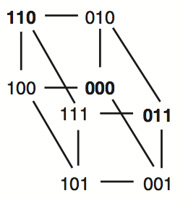
Review: Simple Parity Check
2 bits -> 3 bits
Detect 1-bit errors
8 patterns total
Only 4 correct patterns
00 -> 000
11 -> 110
10 -> 101
01 -> 011
Hamming distance of this code is 2
1-bit flipping will cause incorrect pattern

Slide 4
Network Layer

Slide 5
IP: Best-effort Network
1. Best-effort network(尽力执行的网络,即并不一定能够保证正确性)
If it cannot dispatch, may discard a packet
2. Guaranteed-delivery network(不现实)
Also called store-and-forward network, no discarding data
Work with complete messages rather than packets
Use disk for buffering to handle peaks
Tracks individual message to make sure none are lost
In real world
No absolute guarantee
Guaranteed-delivery: higher layer; best-effort: lower layer

Slide 6
Duplicate Packets and Suppression
Discarding packets is common case
Many network protocols include timeout and resend mechanism
When a congested forwarder discards a packet
Client does not receive a response as quickly as originally hoped
Users may prepared for duplicate requests and responses
Detecting duplicates may or may not be important

Slide 7
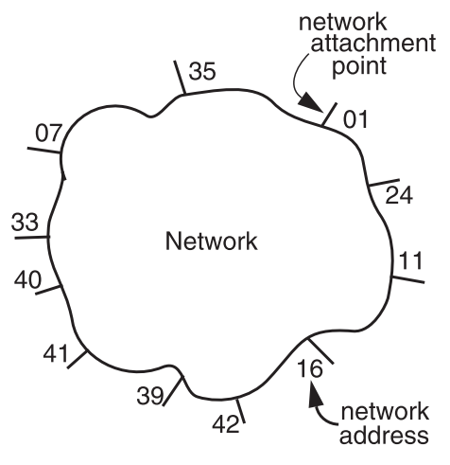
The Network Layer
Addressing interface
Network attachment points
Network address
Source & destination
NETWORK_SEND
(segment_buffer, destnation, network_protocol, end_layer_protocol)
NETWORK_HANDLE
(packet, network_protocol)

Slide 8
Managing the Forwarding Table: Routing
Routing (or path-finding)
Constructing the tables
Impractical by hand
Determining the best paths requires calculation
Recalculating the table when links change
Recalculating the table when link fails
Adapt according to traffic congestion
Static routing vs. adaptive routing
Adaptive routing requires exchange of info
attachment point：
(AP),用于定位

Slide 9
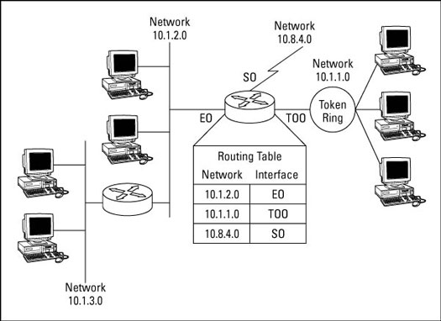
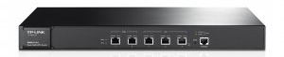
IP Route Table
Interface 1 … Interface N

Slide 10
Control-plane VS. Data-plane
Control-plane
Control the data flow by defining rules
E.g., the routing algorithm
Data-plane
Copies data according to the rules
Performance critical
E.g., the IP forwarding process

Slide 11
Routing
How to generate the routing table?

Slide 12
Goal of A Routing Protocol
Allow each switch to know, for every node dst in the network, a route to dst
Allow each switch to know, for every node dst in the network, a minimum-cost route to dst
Build a routing table at each switch, such that routing_table[dst] contains a minimum-cost route to dst

Slide 13
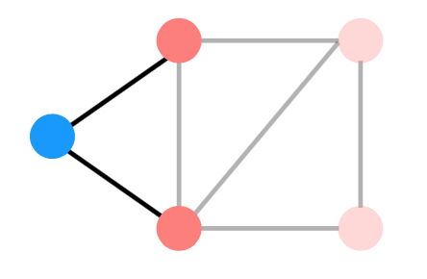
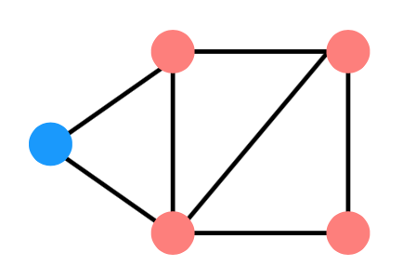
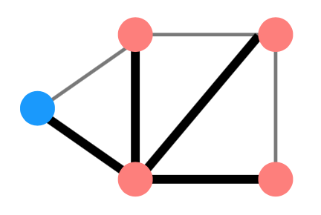
Distributed Routing: 3 Steps in General
Nodes learn about their neighbors via the HELLO protocol
Nodes learn about other reachable nodes via advertisements
Nodes determine the minimum-cost routes (of the routes they know about)
hello protocol指的是一个node通过这个protocol来获取其邻居node的信息并将其加入自己的table中，有新的node成为当前node的邻居是也要通过hello来获取信息。
advertisement是一个node通知其邻居nodes说自己是可以进行路由的，而具体的advertisements方式会由于protocol的不同而不同(后面)

Slide 14
Two Types of Routing Protocol
Protocol 1: Link-state
A node's advertisements contain a list of its neighbors and its link costs to those nodes
Nodes advertise to everyone their costs to their neighbors
via flooding(广播机制)
Integrate using Dijkstra's shortest path algorithm
Protocol 2: Distance-vector
Nodes advertise to neighbors with their cost to all known nodes
Update routes via Bellman-Ford integration
link-state会对所有其他的nodes去广播自己的所有邻居信息以及当前node到这些邻居的最短路径，信息量较大；而distance-vector则是只对于其neighbor进行广告，但是一个node在接受到他人的广告之后会存储在本地，因而会越传递越多，但是一次传输的目的nodes比较少。

Slide 15
link-state routing: disseminate full topology information so that nodes can run a shortest-path algorithm
link state
B
3
C
7
1
5
A
2
D
4
1
3
F
5
E

Slide 16
link-state routing: disseminate full topology information so that nodes can run a shortest-path algorithm
link state
B
3
C
what’s in an advertisement
its link costs to each of its neighbors
7
1
5
A
2
D
4
1
3
F
5
E

Slide 17
link-state routing: disseminate full topology information so that nodes can run a shortest-path algorithm
link state
B
3
C
what’s in an advertisement
its link costs to each of its neighbors
7
1
5
A
2
D
4
1
3
F E
5
A’s advertisement: [(B,7),(D,2),(F,1)]

Slide 18
link-state routing: disseminate full topology information so that nodes can run a shortest-path algorithm
link state
what’s in an advertisement
its link costs to each of its neighbors
who gets a node’s advertisement
B
3
C
7
1
5
A
2
D
4
1
3
F E
5
A’s advertisement: [(B,7),(D,2),(F,1)]

Slide 19
link-state routing: disseminate full topology information so that nodes can run a shortest-path algorithm
link state
what’s in an advertisement
its link costs to each of its neighbors
who gets a node’s advertisement
effectively, every other node (via flooding)
B
3
C
7
1
5
A
2
D
4
1
3
F E
5
A’s advertisement: [(B,7),(D,2),(F,1)]

Slide 20
link-state routing: disseminate full topology information so that nodes can run a shortest-path algorithm
link state
what’s in an advertisement
its link costs to each of its neighbors
who gets a node’s advertisement
effectively, every other node (via flooding)
B
3
C
7
1
5
A
2
D
4
1
3
F E
5
A’s advertisement: [(B,7),(D,2),(F,1)]

Slide 21
link-state routing: disseminate full topology information so that nodes can run a shortest-path algorithm
link state
what’s in an advertisement
its link costs to each of its neighbors
who gets a node’s advertisement
effectively, every other node (via flooding)
B
3
C
7
1
5
A
2
D
4
1
3
F E
5
A’s advertisement: [(B,7),(D,2),(F,1)]

Slide 22
link-state routing: disseminate full topology information so that nodes can run a shortest-path algorithm
link state
what’s in an advertisement
its link costs to each of its neighbors
who gets a node’s advertisement
effectively, every other node (via flooding)
B
3
C
7
1
5
A
2
D
4
1
3
F E
5
A’s advertisement: [(B,7),(D,2),(F,1)]

Slide 23
link-state routing: disseminate full topology information so that nodes can run a shortest-path algorithm
link state
what’s in an advertisement
its link costs to each of its neighbors
who gets a node’s advertisement
effectively, every other node (via flooding)
B
3
C
7
1
5
A
2
D
4
1
3
F E
5
A’s advertisement: [(B,7),(D,2),(F,1)]

Slide 24
link-state routing: disseminate full topology information so that nodes can run a shortest-path algorithm
link state
what’s in an advertisement
its link costs to each of its neighbors
who gets a node’s advertisement
effectively, every other node (via flooding)
B
3
C
7
1
5
A
2
D
4
1
3
F E
5
A’s advertisement: [(B,7),(D,2),(F,1)]

Slide 25
link-state routing: disseminate full topology information so that nodes can run a shortest-path algorithm
link state
what’s in an advertisement
its link costs to each of its neighbors
who gets a node’s advertisement
effectively, every other node (via flooding)
B
3
C
7
1
5
A
2
D
4
1
3
F E
5
A’s advertisement: [(B,7),(D,2),(F,1)]

Slide 26
link-state routing: disseminate full topology information so that nodes can run a shortest-path algorithm
link state
what’s in an advertisement
its link costs to each of its neighbors
who gets a node’s advertisement
effectively, every other node (via flooding)
B
3
C
7
1
5
A
2
D
4
1
3
F E
5
A’s advertisement: [(B,7),(D,2),(F,1)]

Slide 27
link-state routing: disseminate full topology information so that nodes can run a shortest-path algorithm
link state
what’s in an advertisement
its link costs to each of its neighbors
who gets a node’s advertisement
effectively, every other node (via flooding)
B
3
C
7
1
5
A
2
D
4
1
3
F E
5
A’s advertisement: [(B,7),(D,2),(F,1)]

Slide 28
link-state routing: disseminate full topology information so that nodes can run a shortest-path algorithm
link state
B
3
C
what’s in an advertisement
its link costs to each of its neighbors
7
1
5
who gets a node’s advertisement
A
2
D
effectively, every other node (via flooding)
4
1
3
F E
5
A’s advertisement: [(B,7),(D,2),(F,1)]
nodes keep track of which advertisements they’ve forwarded so that they don’t re-forward them

Slide 29
link-state routing: disseminate full topology information so that nodes can run a shortest-path algorithm
link state
B
3
C
what’s in an advertisement
its link costs to each of its neighbors
7
1
5
who gets a node’s advertisement
A
2
D
effectively, every other node (via flooding)
4
1
3
这个步骤可以进行一定的优化来减少flooding的时候传输的节点数量，比如对于一个node，它可以记录自己当前的信息是哪个节点发给他的，那么这个节点在进行自己的flooding的时候就不需要再次发送给那个node了。
F E
5
A’s advertisement: [(B,7),(D,2),(F,1)]
nodes keep track of which advertisements they’ve forwarded so that they don’t re-forward them
they can also be a bit smarter about flooding, and not forward an advertisement back to the node that sent it

Slide 30
link-state routing: disseminate full topology information so that nodes can run a shortest-path algorithm
link state
B
3
C
what’s in an advertisement
its link costs to each of its neighbors
7
1
5
who gets a node’s advertisement
A
2
D
effectively, every other node (via flooding)
4
1
3
F
5
E
nodes integrate advertisements by running Dijkstra’s Algorithm

Slide 31
link-state routing: disseminate full topology information so that nodes can run a shortest-path algorithm
link state
B
3
C
what’s in an advertisement
its link costs to each of its neighbors
7
1
5
who gets a node’s advertisement
A
2
D
effectively, every other node (via flooding)
4
需要注意的是，我们这里实现的route-table是只会记录一个node发出的包将第一个到达的节点。而不会在一个节点把之后的所有路径都记录一遍。
1
3
F
5
E
A’s routing table
dst | route | cost
B | | | A-B | | | 7
C | | | ? | | | ∞
D | | | A-D | | | 2
E | | | ? | | | ∞
F | | | A-F | | | 1

Slide 32
Link-state Routing
Keep track of W, the set of nodes haven't processed yet
Initially, W is all nodes in the network
Keep track of the current costs and routes to all of the nodes. Initially:
routing_table[self] = Self; routing_table[anyone else] = ?
cost_table[self] = 0; cost_table[anyone else] = infinity
While W is not empty:
1. u = the node in W we have the minimum cost to so far
2. Remove u from W
3. For every neighbor v of u: d = cost_table[u] + cost(u, v) if d < cost_table[v] cost_table[v] = d routing_table[v] = routing_table[u]

Slide 33
link-state routing: disseminate full topology information so that nodes can run a shortest-path algorithm
link state
B
3
C
what’s in an advertisement
its link costs to each of its neighbors
7
1
5
who gets a node’s advertisement
A
2
D
effectively, every other node (via flooding)
4
1
3
F
5
E
A’s routing table
dst | route | cost
B | | | A-B | | | 7
C | | | ? | | | ∞
D | | | A-D | | | 2
E | | | ? | | | ∞
F | | | A-F | | | 1

Slide 34
link-state routing: disseminate full topology information so that nodes can run a shortest-path algorithm
link state
B
3
C
what’s in an advertisement
its link costs to each of its neighbors
7
1
5
who gets a node’s advertisement
A
2
D
effectively, every other node (via flooding)
4
1
3
F
5
E
A’s routing table
dst | route | cost
B | | | A-B | | | 7
C | | | ? | | | ∞
D | | | A-D | | | 2
E | | | ? | | | ∞
F | | | A-F | | | 1

Slide 35
link-state routing: disseminate full topology information so that nodes can run a shortest-path algorithm
link state
B
3
C
what’s in an advertisement
its link costs to each of its neighbors
7
1
5
who gets a node’s advertisement
A
2
D
effectively, every other node (via flooding)
4
1
3
F
5
E
A’s routing table
dst | route | cost
B | | | A-B | | | 7
C | | | ? | | | ∞
D | | | A-D | | | 2
E | | | ? | | | ∞
F | | | A-F | | | 1

Slide 36
link-state routing: disseminate full topology information so that nodes can run a shortest-path algorithm
link state
B
3
C
what’s in an advertisement
its link costs to each of its neighbors
7
1
5
who gets a node’s advertisement
A
2
D
effectively, every other node (via flooding)
4
1
3
F
5
E
A’s routing table
dst | route | cost
B | | | A-B | | | 7
C | | | ? | | | ∞
D | | | A-D | | | 2
E | | | ? | | | ∞
F | | | A-F | | | 1
F does not provide A with a better route to D

Slide 37
link-state routing: disseminate full topology information so that nodes can run a shortest-path algorithm
link state
B
3
C
what’s in an advertisement
its link costs to each of its neighbors
7
1
5
who gets a node’s advertisement
A
2
D
effectively, every other node (via flooding)
4
1
3
F
5
E
A’s routing table
dst | route | cost
B | | | A-B | | | 7
C | | | ? | | | ∞
D | | | A-D | | | 2
E | | | ? | | | ∞
F | | | A-F | | | 1

Slide 38
link-state routing: disseminate full topology information so that nodes can run a shortest-path algorithm
link state
B
3
C
what’s in an advertisement
its link costs to each of its neighbors
7
1
5
who gets a node’s advertisement
A
2
D
effectively, every other node (via flooding)
4
1
3
F
5
E
A’s routing table
dst | route | cost
B | | | A-B | | | 7
C | | | ? | | | ∞
D | | | A-D | | | 2
E | | | A-F | | | 6
F | | | A-F | | | 1
= the cost from A to F + the cost from F to E

Slide 39
link-state routing: disseminate full topology information so that nodes can run a shortest-path algorithm
link state
B
3
C
what’s in an advertisement
its link costs to each of its neighbors
7
1
5
who gets a node’s advertisement
A
2
D
effectively, every other node (via flooding)
4
1
3
F
5
E
A’s routing table
dst | route | cost
B | | | A-B | | | 7
C | | | ? | | | ∞
D | | | A-D | | | 2
E | | | A-F | | | 6
F | | | A-F | | | 1

Slide 40
link-state routing: disseminate full topology information so that nodes can run a shortest-path algorithm
link state
B
3
C
what’s in an advertisement
its link costs to each of its neighbors
7
1
5
who gets a node’s advertisement
A
2
D
effectively, every other node (via flooding)
4
1
3
F
5
E
A’s routing table
dst | route | cost
B | | | A-B | | | 7
C | | | ? | | | ∞
D | | | A-D | | | 2
E | | | A-F | | | 6
F | | | A-F | | | 1

Slide 41
link-state routing: disseminate full topology information so that nodes can run a shortest-path algorithm
link state
B
3
C
what’s in an advertisement
its link costs to each of its neighbors
7
1
5
who gets a node’s advertisement
A
2
D
effectively, every other node (via flooding)
4
1
3
F
5
E
A’s routing table
dst | route | cost
B | | | A-B | | | 7
C | | | ? | | | ∞
D | | | A-D | | | 2
E | | | A-F | | | 6
F | | | A-F | | | 1

Slide 42
link-state routing: disseminate full topology information so that nodes can run a shortest-path algorithm
link state
B
3
C
what’s in an advertisement
its link costs to each of its neighbors
7
1
5
who gets a node’s advertisement
A
2
D
effectively, every other node (via flooding)
4
1
3
F
5
E
A’s routing table
dst | route | cost
B | | | A-B | | | 3
C | | | ? | | | ∞
D | | | A-D | | | 2
E | | | A-F | | | 6
F | | | A-F | | | 1

Slide 43
link-state routing: disseminate full topology information so that nodes can run a shortest-path algorithm
link state
B
3
C
what’s in an advertisement
its link costs to each of its neighbors
7
1
5
who gets a node’s advertisement
A
2
D
effectively, every other node (via flooding)
4
1
3
F
5
E
A’s routing table
dst | route | cost
B | | | A-B | | | 3
C | | | ? | | | ∞
D | | | A-D | | | 2
E | | | A-F | | | 6
F | | | A-F | | | 1

Slide 44
link-state routing: disseminate full topology information so that nodes can run a shortest-path algorithm
link state
B
3
C
what’s in an advertisement
its link costs to each of its neighbors
7
1
5
who gets a node’s advertisement
A
2
D
effectively, every other node (via flooding)
4
1
3
F
5
E
A’s routing table
dst | route | cost
B | | | A-B | | | 3
C | | | A-D | | | 7
D | | | A-D | | | 2
E | | | A-F | | | 6
F | | | A-F | | | 1

Slide 45
link-state routing: disseminate full topology information so that nodes can run a shortest-path algorithm
link state
B
3
C
what’s in an advertisement
its link costs to each of its neighbors
7
1
5
who gets a node’s advertisement
A
2
D
effectively, every other node (via flooding)
4
1
3
F
5
E
A’s routing table
dst | route | cost
B | | | A-B | | | 3
C | | | A-D | | | 7
D | | | A-D | | | 2
E | | | A-F | | | 6
F | | | A-F | | | 1

Slide 46
link-state routing: disseminate full topology information so that nodes can run a shortest-path algorithm
link state
B
3
C
what’s in an advertisement
its link costs to each of its neighbors
7
1
5
who gets a node’s advertisement
A
2
D
effectively, every other node (via flooding)
4
1
3
F
5
E
A’s routing table
dst | route | cost
B | | | A-B | | | 3
C | | | A-D | | | 7
D | | | A-D | | | 2
E | | | A-D | | | 5
F | | | A-F | | | 1

Slide 47
link-state routing: disseminate full topology information so that nodes can run a shortest-path algorithm
link state
what’s in an advertisement
its link costs to each of its neighbors
who gets a node’s advertisement
effectively, every other node (via flooding)
B
3
C
7
1
5
A
2
D
4
1
3
F
5
E
A’s routing table
dst | route | cost
B | | | A-B | | | 3
C | | | A-D | | | 7
D | | | A-D | | | 2
E | | | A-D | | | 5
F | | | A-F | | | 1
we don’t need to “visit” F; we already know the shortest path to it

Slide 48
link-state routing: disseminate full topology information so that nodes can run a shortest-path algorithm
link state
B
3
C
what’s in an advertisement
its link costs to each of its neighbors
7
1
5
who gets a node’s advertisement
A
2
D
effectively, every other node (via flooding)
4
1
3
F
5
E
A’s routing table
dst | route | cost
B | | | A-B | | | 3
C | | | A-D | | | 7
D | | | A-D | | | 2
E | | | A-D | | | 5
F | | | A-F | | | 1

Slide 49
link-state routing: disseminate full topology information so that nodes can run a shortest-path algorithm
link state
B
3
C
what’s in an advertisement
its link costs to each of its neighbors
7
1
5
who gets a node’s advertisement
A
2
D
effectively, every other node (via flooding)
4
1
3
F
5
E
A’s routing table
dst | route | cost
B | | | A-B | | | 3
C | | | A-D | | | 7
D | | | A-D | | | 2
E | | | A-D | | | 5
F | | | A-F | | | 1

Slide 50
link-state routing: disseminate full topology information so that nodes can run a shortest-path algorithm
link state
what’s in an advertisement
its link costs to each of its neighbors
who gets a node’s advertisement
effectively, every other node (via flooding)
B
3
C
7
1
5
A
2
D
4
1
3
F
5
E
A’s routing table
dst | route | cost
B | | | A-B | | | 3
C | | | A-D | | | 6
D | | | A-D | | | 2
E | | | A-D | | | 5
F | | | A-F | | | 1
notice that A’s route doesn’t change, but the cost needs to update
(and the actual path of the packets from A to C has changed)

Slide 51
link-state routing: disseminate full topology information so that nodes can run a shortest-path algorithm
link state
B
3
C
what’s in an advertisement
its link costs to each of its neighbors
7
1
5
who gets a node’s advertisement
A
2
D
effectively, every other node (via flooding)
4
1
3
F
5
E
A’s routing table
dst | route | cost
B | | | A-B | | | 3
C | | | A-D | | | 6
D | | | A-D | | | 2
E | | | A-D | | | 5
F | | | A-F | | | 1

Slide 52
link-state routing: disseminate full topology information so that nodes can run a shortest-path algorithm
link state
B
3
C
what’s in an advertisement
its link costs to each of its neighbors
7
1
5
who gets a node’s advertisement
A
2
D
effectively, every other node (via flooding)
4
1
3
F
5
E
A’s routing table
dst | route | cost
B | | | A-B | | | 3
C | | | A-D | | | 6
D | | | A-D | | | 2
E | | | A-D | | | 5
F | | | A-F | | | 1

Slide 53
link-state routing: disseminate full topology information so that nodes can run a shortest-path algorithm
link state
B
3
C
what’s in an advertisement
its link costs to each of its neighbors
7
1
5
who gets a node’s advertisement
A
2
D
effectively, every other node (via flooding)
4
1
3
F
5
E
A’s routing table
dst | route | cost
B | | | A-B | | | 3
C | | | A-D | | | 6
D | | | A-D | | | 2
E | | | A-D | | | 5
F | | | A-F | | | 1

Slide 54
link-state routing: disseminate full topology information so that nodes can run a shortest-path algorithm
link state
B
3
C
what’s in an advertisement
its link costs to each of its neighbors
7
1
5
who gets a node’s advertisement
A
2
D
effectively, every other node (via flooding)
4
1
3
what happens when things fail?
flooding makes link- state routing very resilient to failure
F
5
E
link-state的failure:因为link-state在进行flooding的时候会一次指向其邻居发送自己的信息，所以如果一次发送过程中出现了crash，只需要修改路径，及通过其他正确的节点来发给那个crash的节点就好了。
缺点：新的node添加进来的时候需要重新flooding；
为了检测节点运转正确，需要定期的进行flooding。
what limits scale?
the overhead of flooding

Slide 55
Distance-vector Routing
In link-state, nodes calculate full shortest paths. But actually they only need the route (first-hop) to a destination
Advertisement format: Each node's advertisement is a list of all the nodes it knows about, and its current costs to those nodes
Initially, this advertisement is just [(self, 0)].
Nodes who receive an advertisement: Node X's advertisement will be received only by its neighbors
Integrate step: When node X receives an advertisement from its neighbor Y, this advertisement will be a list of [(dst, cost)] pairs. Each cost represents Y's cost to dst
这个”know about”是包括这个node本来的neighbor以及其neighbor接受的neightbor(的neighbor的...)的信息

Slide 56
Distance-vector Routing
For each (dst, cost) in the advertisement, X needs to check for two things:
If X is already using Y to get to dst, update the cost information (remember, costs can change!) (因为不能保证到达y之后到达dist之前的其余路径点还是一样的)
If X is not using Y to get to dst, see if Y could provide a better path; if so, update the routing and cost information

Slide 57
distance-vector routing: disseminate information about the current costs to each node, rather than the actual topology
link state distance vector
what’s in an advertisement
B
3
C
its link costs to each of its neighbors
7
1
5
who gets a node’s advertisement
A
2
D
effectively, every other node (via flooding)
4
1
3
what happens when things fail?
flooding makes link- state routing very resilient to failure
F
5
E
what limits scale?
the overhead of flooding

Slide 58
distance-vector routing: disseminate information about the current costs to each node, rather than the actual topology
link state distance vector
what’s in an advertisement
B
3
C
its link costs to each of its neighbors
its current costs to
every node it’s aware of
7
1
5
who gets a node’s advertisement
A
2
D
effectively, every other node (via flooding)
4
1
3
what happens when things fail?
flooding makes link- state routing very resilient to failure
F
5
E
what limits scale?
the overhead of flooding

Slide 59
distance-vector routing: disseminate information about the current costs to each node, rather than the actual topology
link state distance vector
what’s in an advertisement
B
3
C
its link costs to each of its neighbors
its current costs to
every node it’s aware of
7
1
5
who gets a node’s advertisement
A
2
D
effectively, every other node (via flooding)
4
1
3
what happens when things fail?
flooding makes link- state routing very resilient to failure
F E
5
A’s first advertisement: [(B,7),(D,2),(F,1)]
A could also include (A,0) here
A’s routing table
what limits scale?
the overhead of flooding
dst | route | cost
A’s advertisement reflects its routing table, and right now, A only knows about its neighbors
B | A-B | 7 D | A-D | 2
F
|
A-F
|
1

Slide 60
distance-vector routing: disseminate information about the current costs to each node, rather than the actual topology
link state distance vector
what’s in an advertisement
B
3
C
its link costs to each of its neighbors
its current costs to
every node it’s aware of
7
1
5
who gets a node’s advertisement
A
2
D
effectively, every other node (via flooding)
only its neighbors
4
1
3
what happens when things fail?
flooding makes link- state routing very resilient to failure
F E
5
A’s first advertisement: [(B,7),(D,2),(F,1)]
A could also include (A,0) here
A’s routing table
what limits scale?
the overhead of flooding
dst | route | cost
A’s advertisement reflects its routing table, and right now, A only knows about its neighbors
B | A-B | 7 D | A-D | 2
F
|
A-F
|
1

Slide 61
distance-vector routing: disseminate information about the current costs to each node, rather than the actual topology
link state distance vector
what’s in an advertisement
B
3
C
its link costs to each of its neighbors
its current costs to
every node it’s aware of
7
1
5
who gets a node’s advertisement
A
2
D
effectively, every other node (via flooding)
only its neighbors
4
1
3
what happens when things fail?
flooding makes link- state routing very resilient to failure
F E
5
A’s first advertisement: [(B,7),(D,2),(F,1)]
A could also include (A,0) here
A’s routing table
what limits scale?
the overhead of flooding
dst | route | cost
A’s advertisement reflects its routing table, and right now, A only knows about its neighbors
B | A-B | 7 D | A-D | 2
F
|
A-F
|
1

Slide 62
distance-vector routing: disseminate information about the current costs to each node, rather than the actual topology
link state distance vector
what’s in an advertisement
B
3
C
its link costs to each of its neighbors
its current costs to
every node it’s aware of
7
1
5
who gets a node’s advertisement
A
2
D
effectively, every other node (via flooding)
only its neighbors
4
1
3
what happens when things fail?
flooding makes link- state routing very resilient to failure
F E
5
A’s first advertisement: [(B,7),(D,2),(F,1)]
A could also include (A,0) here
A’s routing table
what limits scale?
the overhead of flooding
dst | route | cost
A’s advertisement reflects its routing table, and right now, A only knows about its neighbors
B | A-B | 7 D | A-D | 2
F
|
A-F
|
1

Slide 63
distance-vector routing: disseminate information about the current costs to each node, rather than the actual topology
link state distance vector
what’s in an advertisement
B
3
C
its link costs to each of its neighbors
its current costs to
every node it’s aware of
7
1
5
who gets a node’s advertisement
A
2
D
effectively, every other node (via flooding)
only its neighbors
4
1
3
what happens when things fail?
flooding makes link- state routing very resilient to failure
F E
5
A’s first advertisement: [(B,7),(D,2),(F,1)]
what limits scale?
A’s routing table
dst | route | cost
the overhead of flooding
A’s neighbors do not forward A’s advertisements; they do send advertisements of their own to A
B | A-B | 7 D | A-D | 2
F
|
A-F
|
1

Slide 64
distance-vector routing: disseminate information about the current costs to each node, rather than the actual topology
link state distance vector
what’s in an advertisement
B
3
C
its link costs to each of its neighbors
its current costs to
every node it’s aware of
7
1
5
who gets a node’s advertisement
A
2
D
effectively, every other node (via flooding)
only its neighbors
4
1
3
what happens when things fail?
flooding makes link- state routing very resilient to failure
F E
5
A’s first advertisement: [(B,7),(D,2),(F,1)]
what limits scale?
A’s routing table
dst | route | cost
the overhead of flooding
A’s neighbors do not forward A’s advertisements; they do send advertisements of their own to A
B | A-B | 7 D | A-D | 2
F
|
A-F
|
1

Slide 65
distance-vector routing: disseminate information about the current costs to each node, rather than the actual topology
link state distance vector
what’s in an advertisement
B
3
C
its link costs to each of its neighbors
its current costs to
every node it’s aware of
7
1
5
who gets a node’s advertisement
A
2
D
effectively, every other node (via flooding)
only its neighbors
4
1
3
what happens when things fail?
flooding makes link- state routing very resilient to failure
F E
5
A’s first advertisement: [(B,7),(D,2),(F,1)]
what limits scale?
A’s routing table
dst | route | cost
the overhead of flooding
A’s neighbors do not forward A’s advertisements; they do send advertisements of their own to A
B | A-B | 7 D | A-D | 2
F
|
A-F
|
1

Slide 66
distance-vector routing: disseminate information about the current costs to each node, rather than the actual topology
link state distance vector
what’s in an advertisement
B
3
C
its link costs to each of its neighbors
its current costs to
every node it’s aware of
7
1
5
who gets a node’s advertisement
A
2
D
effectively, every other node (via flooding)
only its neighbors
4
1
3
what happens when things fail?
flooding makes link- state routing very resilient to failure
F E
5
A’s first advertisement: [(B,7),(D,2),(F,1)]
what limits scale?
A’s routing table
dst | route | cost
the overhead of flooding
A’s neighbors do not forward A’s advertisements; they do send advertisements of their own to A
B | A-B | 7 D | A-D | 2
F
|
A-F
|
1

Slide 67
distance-vector routing: disseminate information about the current costs to each node, rather than the actual topology
link state distance vector
what’s in an advertisement
B
3
C
its link costs to each of its neighbors
its current costs to
every node it’s aware of
7
1
5
who gets a node’s advertisement
A
2
D
effectively, every other node (via flooding)
only its neighbors
4
1
3
what happens when things fail?
flooding makes link- state routing very resilient to failure
F
5
E
what limits scale?
A’s routing table
dst | route | cost
B’s | first | adv: | [(A,7), | (C,3), | (D,1)]
D’s | first | adv: | [(B,1), | (C,5), | (E,3), | (F,4)(A,2)]
F’s | first | adv: | [(A,1), | (D,4), | (E,5)]
the overhead of flooding
B | A-B | 7 D | A-D | 2
F
|
A-F
|
1
A receives advertisements
from B, D, and F

Slide 68
distance-vector routing: disseminate information about the current costs to each node, rather than the actual topology
link state distance vector
what’s in an advertisement
B
3
C
its link costs to each of its neighbors
its current costs to
every node it’s aware of
7
1
5
who gets a node’s advertisement
A
2
D
effectively, every other node (via flooding)
only its neighbors
4
1
3
what happens when things fail?
flooding makes link- state routing very resilient to failure
F
5
E
what limits scale?
A’s routing table
dst | route | cost
B’s | first | adv: | [(A,7), | (C,3), | (D,1)]
the overhead of flooding
B | A-B | 7 D | A-D | 2
F
|
A-F
|
1

Slide 69
distance-vector routing: disseminate information about the current costs to each node, rather than the actual topology
link state distance vector
what’s in an advertisement
B
3
C
its link costs to each of its neighbors
its current costs to
every node it’s aware of
7
1
5
who gets a node’s advertisement
A
2
D
effectively, every other node (via flooding)
only its neighbors
4
1
3
what happens when things fail?
flooding makes link- state routing very resilient to failure
F
5
E
what limits scale?
A’s routing table
dst | route | cost
B’s | first | adv: | [(A,7), | (C,3), | (D,1)]
the overhead of flooding
B | A-B | 7 C | A-B | 10
D | A-D | 2
A's cost to B + B's cost to C
F
|
A-F
|
1

Slide 70
distance-vector routing: disseminate information about the current costs to each node, rather than the actual topology
link state distance vector
what’s in an advertisement
B
3
C
its link costs to each of its neighbors
its current costs to
every node it’s aware of
7
1
5
who gets a node’s advertisement
A
2
D
effectively, every other node (via flooding)
only its neighbors
4
1
3
what happens when things fail?
flooding makes link- state routing very resilient to failure
F
5
E
what limits scale?
A’s routing table
dst | route | cost
B’s | first | adv: | [(A,7), | (C,3), | (D,1)]
D’s | first | adv: | [(B,1), | (C,5), | (E,3), | (F,4)(A,2)]
F’s | first | adv: | [(A,1), | (D,4), | (E,5)]
the overhead of flooding
B | A-B | 7 C | A-B | 10
D | A-D | 2
F
|
A-F
|
1

Slide 71
distance-vector routing: disseminate information about the current costs to each node, rather than the actual topology
link state distance vector
what’s in an advertisement
B
3
C
its link costs to each of its neighbors
its current costs to
every node it’s aware of
7
1
5
who gets a node’s advertisement
A
2
D
effectively, every other node (via flooding)
only its neighbors
4
1
3
what happens when things fail?
flooding makes link- state routing very resilient to failure
F
5
E
what limits scale?
A’s routing table
dst | route | cost
D’s | first | adv: | [(B,1), | (C,5), | (E,3), | (F,4)(A,2)]
the overhead of flooding
B | A-B | 7 C | A-B | 10
D | A-D | 2
F
|
A-F
|
1

Slide 72
distance-vector routing: disseminate information about the current costs to each node, rather than the actual topology
link state distance vector
what’s in an advertisement
B
3
C
its link costs to each of its neighbors
its current costs to
every node it’s aware of
7
1
5
who gets a node’s advertisement
A
2
D
effectively, every other node (via flooding)
only its neighbors
4
1
3
what happens when things fail?
flooding makes link- state routing very resilient to failure
F
5
E
what limits scale?
A’s routing table
dst | route | cost
D’s | first | adv: | [(B,1), | (C,5), | (E,3), | (F,4)(A,2)]
the overhead of flooding
B | A-D | 3 C | A-B | 10
D | A-D | 2
F
|
A-F
|
1

Slide 73
distance-vector routing: disseminate information about the current costs to each node, rather than the actual topology
link state distance vector
what’s in an advertisement
B
3
C
its link costs to each of its neighbors
its current costs to
every node it’s aware of
7
1
5
who gets a node’s advertisement
A
2
D
effectively, every other node (via flooding)
only its neighbors
4
1
3
what happens when things fail?
flooding makes link- state routing very resilient to failure
F
5
E
what limits scale?
A’s routing table
dst | route | cost
D’s | first | adv: | [(B,1), | (C,5), | (E,3), | (F,4)(A,2)]
the overhead of flooding
B | A-D | 3 C | A-D | 7
D | A-D | 2
F
|
A-F
|
1

Slide 74
distance-vector routing: disseminate information about the current costs to each node, rather than the actual topology
link state distance vector
what’s in an advertisement
B
3
C
its link costs to each of its neighbors
its current costs to
every node it’s aware of
7
1
5
who gets a node’s advertisement
A
2
D
effectively, every other node (via flooding)
only its neighbors
4
1
3
what happens when things fail?
flooding makes link- state routing very resilient to failure
F
5
E
what limits scale?
A’s routing table
dst | route | cost
D’s | first | adv: | [(B,1), | (C,5), | (E,3), | (F,4)(A,2)]
the overhead of flooding
B | A-D | 3 C | A-D | 7
D | A-D | 2
E | A-D | 5
F
|
A-F
|
1

Slide 75
distance-vector routing: disseminate information about the current costs to each node, rather than the actual topology
link state distance vector
what’s in an advertisement
B
3
C
its link costs to each of its neighbors
its current costs to
every node it’s aware of
7
1
5
who gets a node’s advertisement
A
2
D
effectively, every other node (via flooding)
only its neighbors
4
1
3
what happens when things fail?
flooding makes link- state routing very resilient to failure
F
5
E
what limits scale?
A’s routing table
dst | route | cost
B’s | first | adv: | [(A,7), | (C,3), | (D,1)]
D’s | first | adv: | [(B,1), | (C,5), | (E,3), | (F,4)(A,2)]
F’s | first | adv: | [(A,1), | (D,4), | (E,5)]
the overhead of flooding
B | A-D | 3 C | A-D | 7
D | A-D | 2
E | A-D | 5
F
|
A-F
|
1

Slide 76
distance-vector routing: disseminate information about the current costs to each node, rather than the actual topology
link state distance vector
what’s in an advertisement
B
3
C
its link costs to each of its neighbors
its current costs to
every node it’s aware of
7
1
5
who gets a node’s advertisement
A
2
D
effectively, every other node (via flooding)
only its neighbors
4
1
3
what happens when things fail?
flooding makes link- state routing very resilient to failure
F
5
E
what limits scale?
A’s routing table
dst | route | cost
the overhead of flooding
F’s first adv: [(A,1), (D,4), (E,5)]
B | A-D | 3 C | A-D | 7
D | A-D | 2
E | A-D | 5
F
|
A-F
|
1

Slide 77
distance-vector routing: disseminate information about the current costs to each node, rather than the actual topology
link state distance vector
what’s in an advertisement
B
3
C
its link costs to each of its neighbors
its current costs to
every node it’s aware of
7
1
5
who gets a node’s advertisement
A
2
D
effectively, every other node (via flooding)
only its neighbors
4
1
3
what happens when things fail?
flooding makes link- state routing very resilient to failure
F
5
E
this is A’s routing table after one round of advertisements; note that it does not have knowledge of the min-cost route to C yet
what limits scale?
A’s routing table
dst | route | cost
the overhead of flooding
B | A-D | 3 C | A-D | 7
D | A-D | 2
E | A-D | 5
F
|
A-F
|
1

Slide 78
distance-vector routing: disseminate information about the current costs to each node, rather than the actual topology
link state distance vector
what’s in an advertisement
B
3
C
its link costs to each of its neighbors
its current costs to
every node it’s aware of
7
1
5
who gets a node’s advertisement
A
2
D
effectively, every other node (via flooding)
only its neighbors
4
1
3
what happens when things fail?
flooding makes link- state routing very resilient to failure
F
5
E
what limits scale?
A’s routing table
dst | route | cost
A’s second adv:
[(B,3), (C,7), (D,2), (E,5), (F,1)]
the overhead of flooding
B | A-D | 3 C | A-D | 7
D | A-D | 2
E | A-D | 5
F
|
A-F
|
1

Slide 79
distance-vector routing: disseminate information about the current costs to each node, rather than the actual topology
link state distance vector
what’s in an advertisement
B
3
C
its link costs to each of its neighbors
its current costs to
every node it’s aware of
7
1
5
who gets a node’s advertisement
A
2
D
effectively, every other node (via flooding)
only its neighbors
4
1
3
what happens when things fail?
flooding makes link- state routing very resilient to failure
F
5
E
what limits scale?
A’s routing table
dst | route | cost
A’s second adv:
[(B,3), (C,7), (D,2), (E,5), (F,1)]
the overhead of flooding
B | A-D | 3 C | A-D | 7
D | A-D | 2
E | A-D | 5
A will learn about the correct min-cost path to C in the next round of advertisements; try that out for yourself!
F
|
A-F
|
1

Slide 80
distance-vector routing: disseminate information about the current costs to each node, rather than the actual topology
link state distance vector
what’s in an advertisement
B
3
C
its link costs to each of its neighbors
its current costs to
every node it’s aware of
7
1
5
who gets a node’s advertisement
A
2
D
effectively, every other node (via flooding)
only its neighbors
4
1
3
what happens when things fail?
flooding makes link- state routing very resilient to failure
failures can be complicated because of timing
F
5
E
dist-vector的问题：一个node的信息一部分是自己原来的，一部分是接受其他node的信息之后添加的/更新的，所以如果有发送信息的其他nodes发生crash的话，则当前节点的信息在一段时间内可能就是错误的。
what limits scale?
the overhead of flooding
failure handling

Slide 81
Problem of INFINITY
When a node A has no route to destination B, it will advertise a cost of INFINITY to B
A cost of INFINITY B is interpreted as there being no route to B
So INFINITY must be larger than the longest path in the network
But because the order in which advertisements are sent matters, sometimes nodes can incorrectly think there's a route when there isn't one
This can last for up to INFINITY steps (usually 16 or 32)

Slide 82
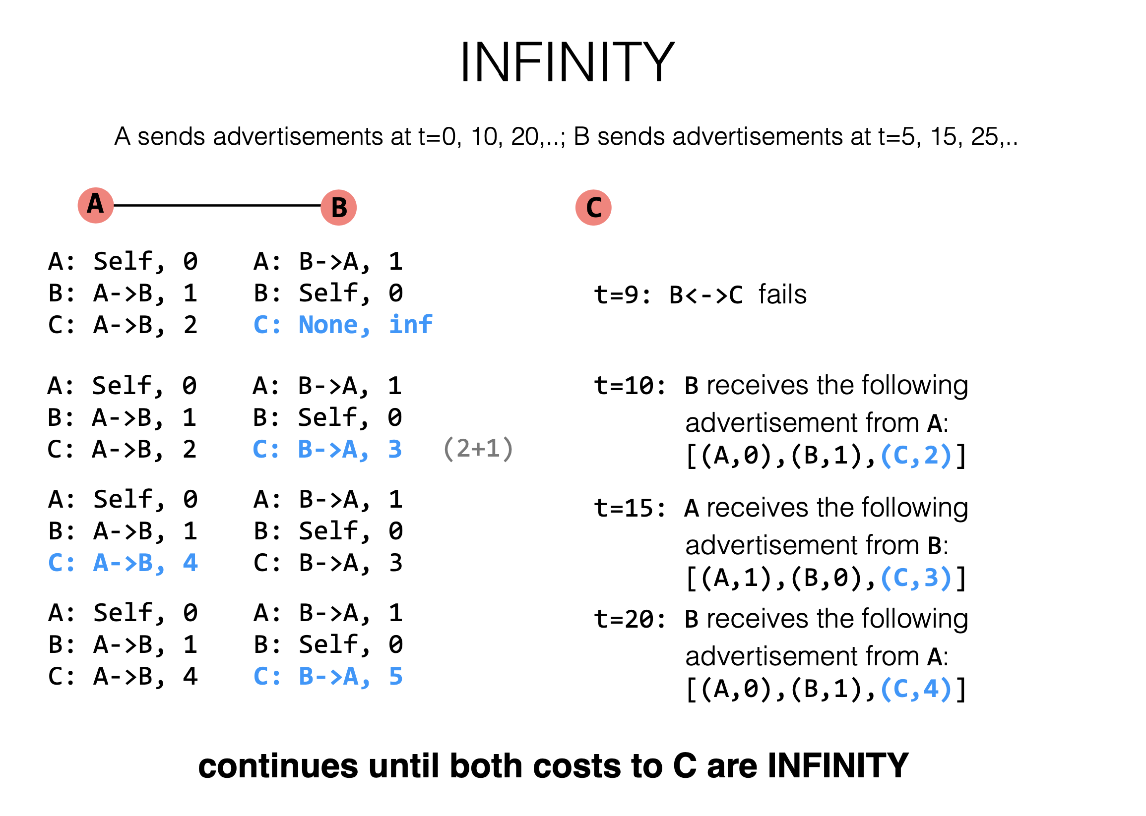

A: Self, 0
B: A->B, 1
C: A->B, 2
A: B->A, 1
B: Self, 0
C: B->C, 1

Slide 84
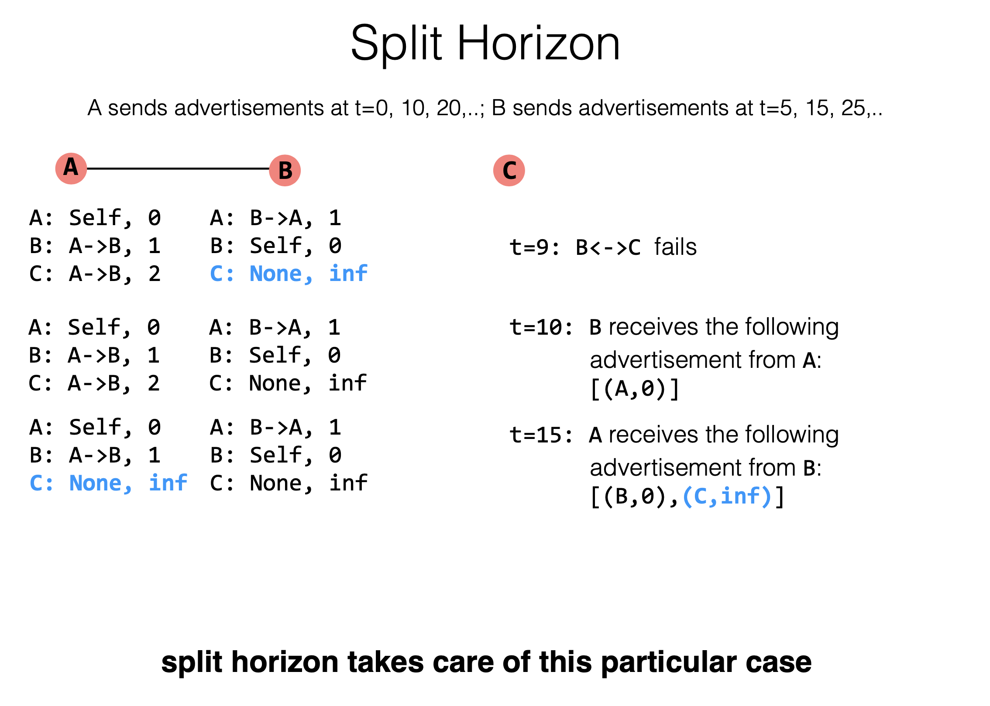
split horizon是在说每一次的传递广告的时候，不再是一次性传递所有的信息，而只是重新发送不是从dst发送过来的信息以及不会经过dst节点的消息，即route消息不能出现原路反向返回的情况。
Notes:
从一端收到的路由信息，不能再从原路被发送回去。

Slide 85
Link-State Summary
Pros:
Fast convergence
Cons:
flooding is costly: 2 x #Node x #Line advertisements
Only good for small networks

Slide 86
Distance Vector
Pros:
Low overhead: 2x #Line advertisements
Cons:
Convergence time is proportional to longest path
The infinity problem
Only good for small networks

Slide 87
How to Scale the Routing?

Slide 88
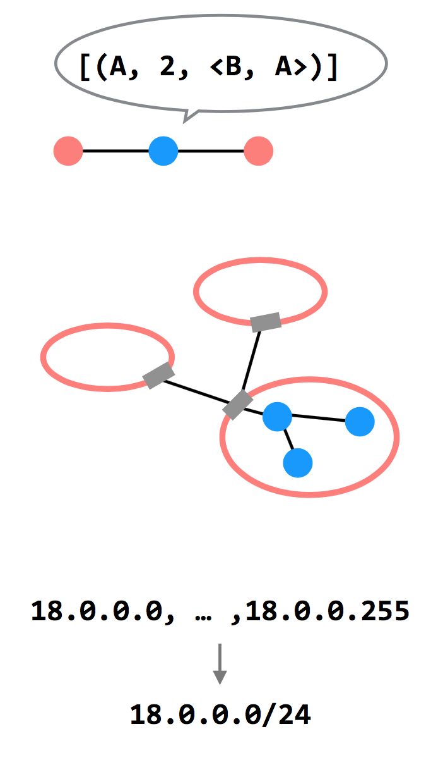
3 Ways to Scale
Path-vector Routing
Advertisements include the path, to better detect routing loops
Hierarchy of Routing
Route between regions, and then within a region
Topological Addressing
Assign addresses in contiguous blocks to make advertisements smaller

Slide 89
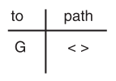
Path Vector Exchange
Each participant maintains a path vector
A complete path to some destination
E.g., zero-length path to itself
Gradually learns about other paths
Construct a new forwarding table from its new path vector
Algorithm
Advertising
Path selection
path vector的route-table不在单单记录当前node的出口，
而是记录从这个node起始到目标node的一个完整路径。

Slide 90
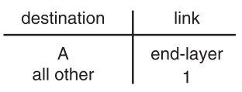
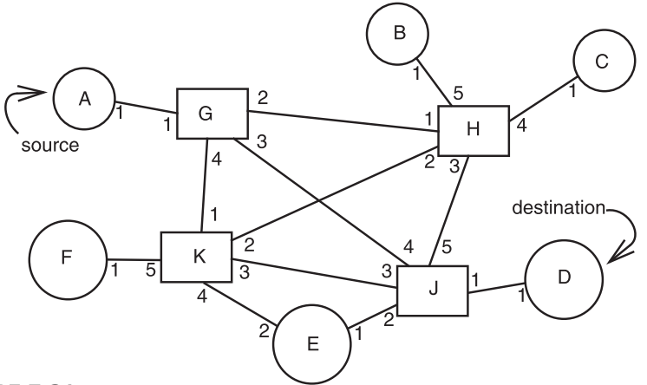
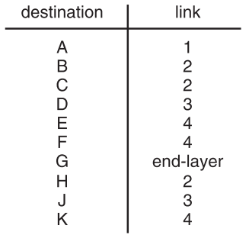
Path Vector Exchange
A
G
这个图中是以G为起始点的
Need coordination to ensure no loop

Slide 91
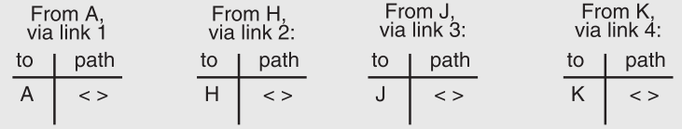
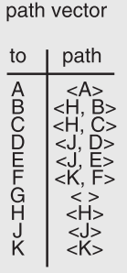
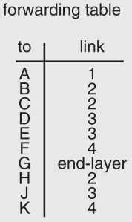
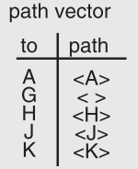
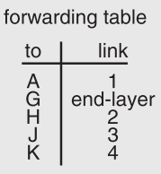
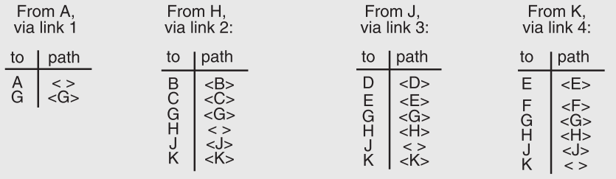

Slide 92
Path Vector Exchange
Better for scaling
Like Distance-Vector, but include the full path in the routing advertisements
Overhead increases (advertises are larger), but convergence time decreases (avoid counting to infinity)
Overhead is still lower than Link-State

Slide 93
Questions on Path Vector
更新路径的时候不更新包含这个节点本身的路径
How do we avoid permanent loops?
When a node updates its paths, it never accepts a path that has itself
What happens when a node hears multiple paths to the same destination?
It picks the better path
What happens if the graph changes?
Algorithm deals well with new links
To deal with links that go down, each router should discard any path that a neighbor stops advertising
better path：路径和最短，跳转次数尽可能的少

Slide 94
Hierarchical Address Assignment & Routing
Two problems of the path vector implementation
Every attachment point must have a unique address
The path vector grows in size with the number of attachment points
Hierarchy for better scalability
Two parts of network address: region & station, e.g., "11,75"
Regions correspond to the set of closely-connected entities
E.g., region-11 has only 1 entry in other region routers' table

Slide 95
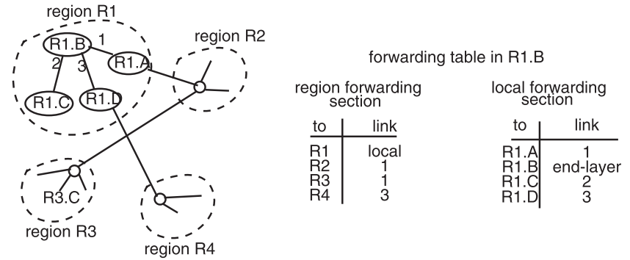
Hierarchical Address Assignment & Routing
hierarchy是将所有node分配到不同的region中去，并对每一个region中的node进行编号，并记录每一个node的location。
IP是与location绑定的，所以同一台机器位置变了，可能IP就变化了。
Region is also as known as AS: Autonomous System(自治系统)

Slide 96
Hierarchical Address Assignment & Routing
Problems introduced by hierarchy: more complex
Binding address(应该指的就是IP address) with location
Has to change address after changing location
Paths may no longer be the shortest possible
Algorithm has less detailed information
More about hierarchy
Can extend to more levels
Different places can have different levels

Slide 97
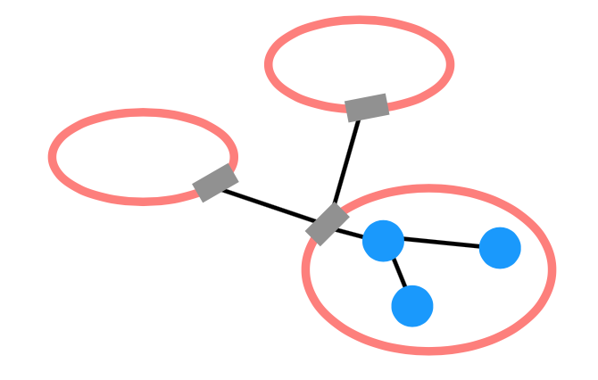
Routing Hierarchy
Across Region
Use one routing protocol to route across regions, and a different protocol to route within regions
Implies that there are devices on the edge of each region that can "translate" between or "speak" both protocols
BGP is the path-vector protocol used across regions
Border Gateway Protocol(边界网关协议)

Slide 98
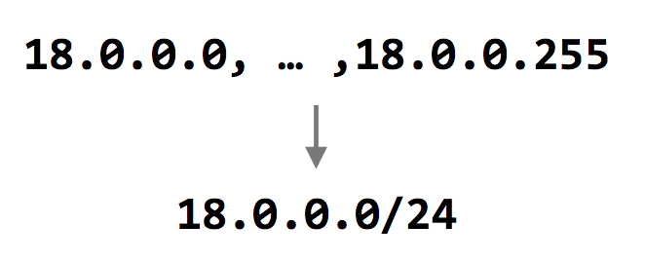
Topological Addressing
Further reduce the routing table
Despite being between regions, BGP still routes to IP addresses (e.g., to 18.0.0.1, not to region-3 )
Addresses are given to regions in contiguous blocks, so that they can be specified succinctly via a particular notation ("CIDR" notation)
CIDR: Classless Inter Domain Routing
Keeps advertisements small
18.0.0.0/24中的24指的是子网掩码中的高地址上面的1的位数。24个1就是对应于255.255.255.0
CIDR Notation

Slide 99
Data Plane: Packet Forwarding

Slide 100
Network Layer Interface
structure packet
bit_string source
bit_string destination
bit_string end_protocol
bit_string payload

Slide 101
1 procedure NETWORK_SEND (segment_buffer, destination,
2 net_protocol, end_protocol)
3 packet instance outgoing_packet
4 outgoing_packet.payload ← segment_buffer
5 outgoing_packet.end_protocol ← end_protocol
6 outgoing_packet.source ← MY_NETWORK_ADDRESS
7 outgoing_packet.destination ← destination
8 NETWORK_HANDLE (outgoing_packet, net_protocol)
9 procedure NETWORK_HANDLE (net_packet, net_protocol)
10 packet instance net_packet
11 if net_packet.destination != MY_NETWORK_ADDRESS then
12 next_hop ← LOOKUP (net_packet.destination, forwarding_table)
13 LINK_SEND (net_packet, next_hop, link_protocol, net_protocol)
14 else
15 GIVE_TO_END_LAYER (net_packet.payload,
16 net_packet.end_protocol, net_packet.source)
此处的network-handler是用于判断packet的dst的。

Slide 103
Forwarding an IP Packet
Lookup packet's destination in forwarding table
If known, find the corresponding outgoing link
If unknown, drop packet
Decrement TTL (Time To Live)
Drop packet if TTL is zero
Update header checksum
Forward packet to outgoing port
Transmit packet onto link
TTL:Time To Live，实际上TTL记录的就是在到达终点之前被转发(route)的次数，每被route一次就减去1，所以当TTL=0的时候就舍弃这个packet(即drop)，
两个node之间最多route 64次。使用TTL来避免一个packet长时间的占据一部分的网络资源。
另外一种进行packet-drop的方法是通过higher-layer(比如用户层的一些额外的判断)来决定是否要丢包，但是通过high-layer来解决lower-layer的问题是不好的架构设计。
forward a packet这个操作是通过kernel来处理的。
checksum是用于保证TTL的正确性的，即保证TTL在传输过程中未发生丢失等情况。

Slide 104
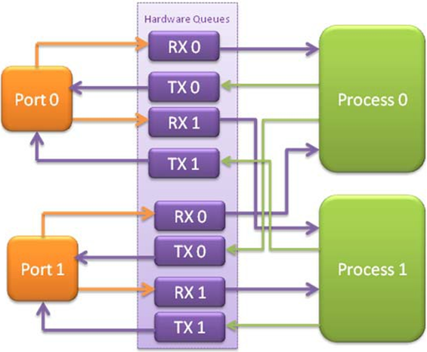
Data-plane Case Study: Intel's DPDK
DPDK: Data Plane Development Kit
Bypass kernel
Network card
Has several ports
A port has RX/TX
Processor
Read packets from RX
Polling
Find output port
Write packets to TX
RX for receiving
TX for sending

Slide 105
NAT

Slide 106
NAT (Network Address Translation)
Private network
Public routers do not accept routes to network 10 (e.g., 10.8.8.8)
NAT router: bridge the private networks
Router between private & public network
Send: modify source address to temp public address
Receive: modify back by looking mapping table
Limitations
Some end-to-end protocols place address in payloads
The translator may become the bottleneck
What if two private network merge?

Slide 107
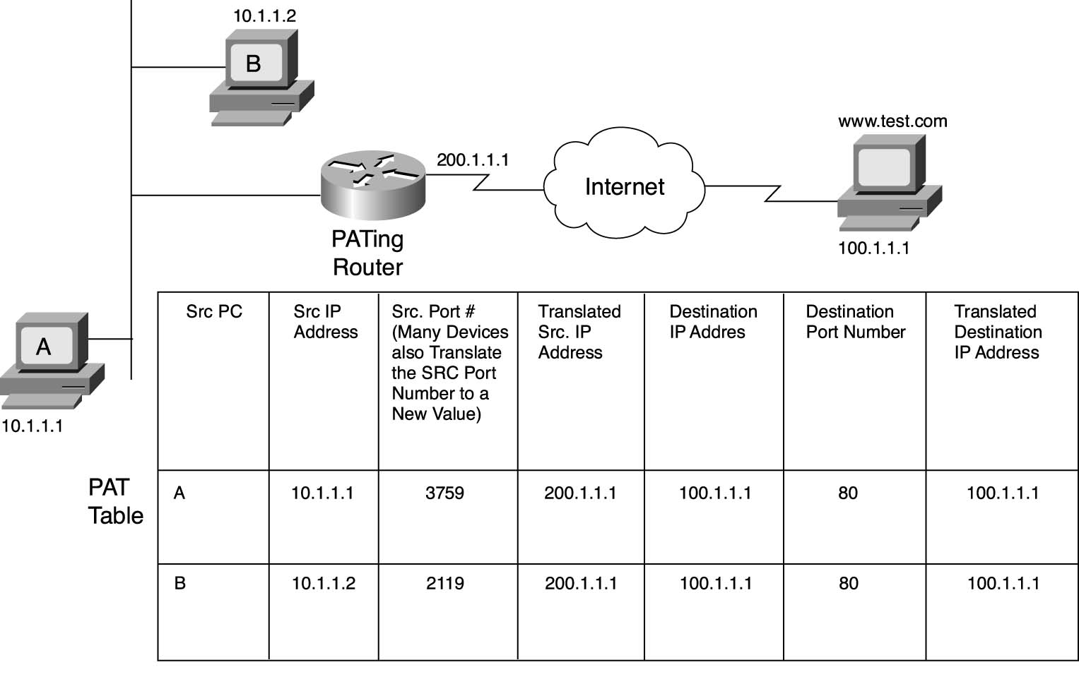
NAT

Slide 109
CASE: Ethernet Mapping
Mapping Internet to Ethernet

Slide 110
Case Study: Mapping Internet to Ethernet
Listen-before-sending rule, collision
Ethernet: CSMA/CD
Carrier Sense Multiple Access with Collision Detection
Ethernet type
Experimental Ethernet, 3 mpbs
Standard Ethernet, 10 mbps
Fast Ethernet, 100 mbps
Gigabit Ethernet, 1000 mbps

Slide 111
Overview of Ethernet
A half duplex Ethernet
The max propagation time is less than the 576 bit times, the shortest allowable packet
So that two parties can detect a collision together
If collision: wait random first time, exponential backoff if repeat
A full duplex & point-to-point Ethernet
No collisions & the max length of the link is determined by the physical medium

Slide 112
Difference between Hub and Switch
Hub
A frame is "broadcast" to every one of its ports
A 10/100Mbps hub must share its bandwidth with each port
Switch
Keeps a record of the MAC addresses of all the devices
A 10/100Mbps switch will allocate a full 10/100Mbps to each of its ports

Slide 113
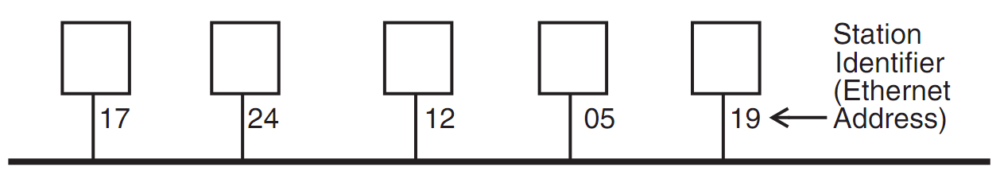
Broadcast Aspects of Ethernet
Broadcast network
Every frame is delivered to every station
(Compare with forwarding network)
ETHERNET_SEND
Pass the call along to the link layer
ETHERNET_HANDLE
Simple, can even be implemented in hardware

Slide 114
Broadcast Aspects of Ethernet
procedure ETHERNET_HANDLE (net_packet, length)
destination ← net_packet.target_id
if destination = my_station_id
then
GIVE_TO_END_LAYER (net_packet.data,
net_packet.end_protocol,
net_packet.source_id)
else
ignore packet
no need to do any forwarding

Slide 115
Broadcast Aspects of Ethernet
procedure ETHERNET_HANDLE (net_packet, length)
destination ← net_packet.target_id
if destination = my_station_id
or destination = BROADCAST_ID
then
GIVE_TO_END_LAYER (net_packet.data,
net_packet.end_protocol,
net_packet.source_id)
else
ignore packet

Slide 116
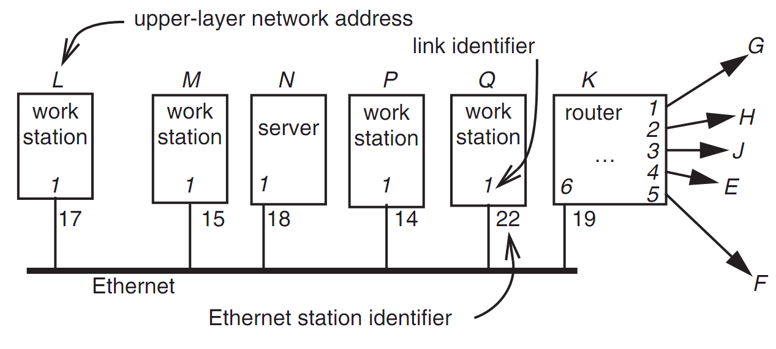
Layer Mapping: Attach Ethernet to Forwarding Network
15
L sends a RPC to N by sending to station 18 of link 1
L sends a RPC to E by sending to K, E may have 15 as address, as well as M

Slide 117
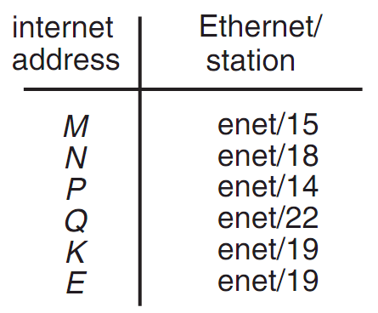
Layer Mapping
The Internet network layer
NETWORK_SEND (data, length, RPC, INTERNET, N)
NETWORK_SEND (data, length, RPC, ENET, 18)
L must maintain a table

Slide 118
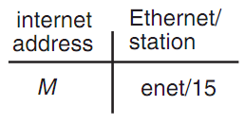
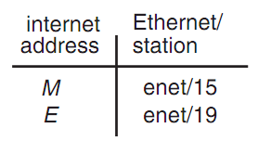
ARP (Address Resolution Protocol)
NETWORK_SEND ("where is M?", 11, ARP, ENET, BROADCAST)
NETWORK_SEND ("M is at station 15", 18, ARP, ENET, BROADCAST)
L asks E's Ethernet address, E does not hear the Ethernet broadcast, but the router at station 19 does, and it sends a suitable ARP response instead
Manage forwarding table as a cache

Slide 119
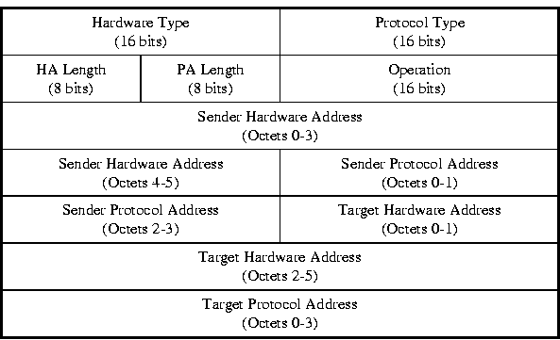
ARP & RARP Protocol
Name mapping: IP address <-> MAC address

Slide 120
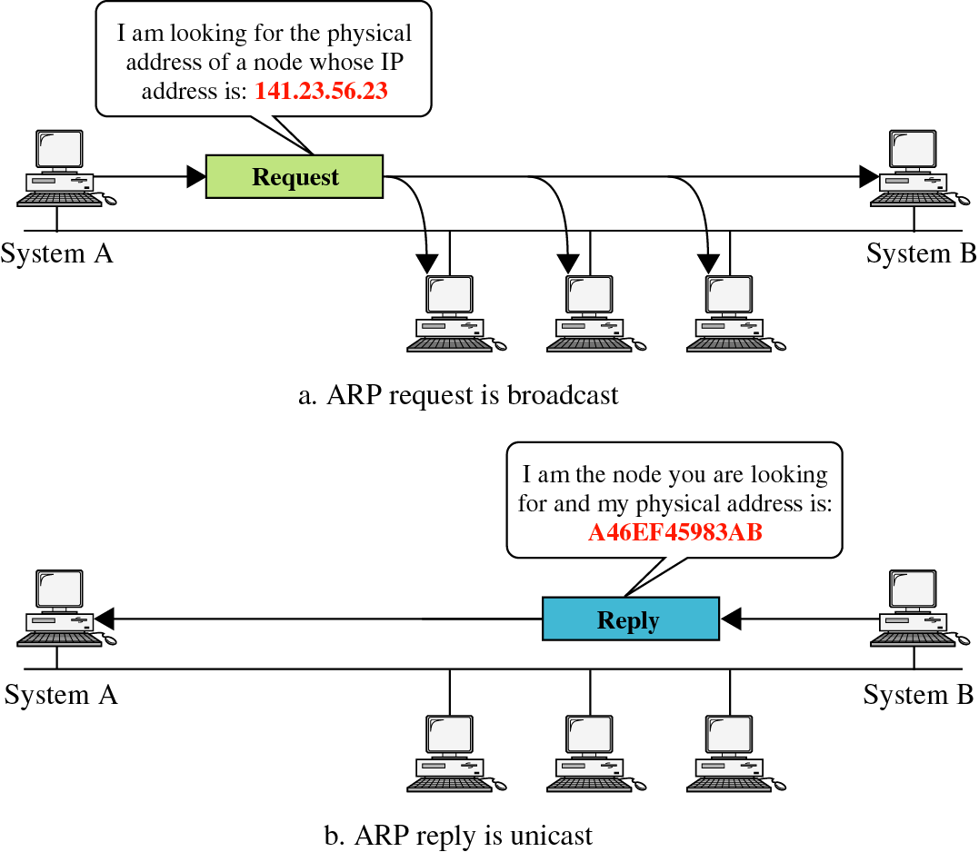
ARP & RARP

Slide 121
Network Topology
Take SJTU network for example
Subnet: usually like 192.168.0.2 or 10.0.0.2
Gateway: usually like 192.168.0.1
Get the global IP address: 202.120.40.82
A gateway usually has two (or more) IP address
Proxy: get proxy's address
E.g., 106.185.46.164 (Japan)

Slide 122
Network Topology

Slide 123
How to Use socket to Access www.baidu.com ?
You code as if your PC connect directly with Baidu
Call connect() with Baidu's IP address
But how does the system find next hop?

Slide 124
Putting All Together
App: I want to send a packet to Baidu, here is the packet with Baidu's IP in its header as target IP, and client's IP as source IP (Node-C)
OS: I don't know how to get to Baidu, I'll just send it to the router (gateway). But I cannot change the source IP of the packet, so I'll just change the MAC target address of the packet to the router's MAC address

Slide 125
Putting All Together
The router-1 (gateway): I get a packet with my MAC as target address. Is it my IP? No… So I'll just forward it to next hop, by changing the target MAC address to next hop's MAC address (NAT: change source IP and source port as well)
Router-2: I connect directly to Baidu, I'll just change the target MAC address to Baidu

Slide 126
ARP Spoofing
Construct spoofed ARP replies
A target computer could be convinced to send frames destined for computer A to instead go to computer B
Computer A will have no idea that this redirection took place
This process of updating a target computer's ARP cache is referred to as "ARP poisoning"

Slide 127
Spoofed ARP reply
IP:10.0.0.2
MAC:cc:cc:cc:cc
Spoofed ARP reply
IP:10.0.0.2
MAC:cc:cc:cc:cc
switch
Spoofed ARP reply
IP:10.0.0.2
MAC:cc:cc:cc:cc
A
IP:10.0.0.1
MAC:aa:aa:aa:aa
B
IP:10.0.0.2
MAC:bb:bb:bb:bb
Hacker
IP:10.0.0.3
MAC:cc:cc:cc:cc
ARP cache
ARP cache
IP | MAC
10.0.0.2 | bb:bb:bb:bb
IP | MAC
10.0.0.1 | aa:aa:aa:aa

Slide 128
switch
A
IP:10.0.0.1
MAC:aa:aa:aa:aa
B
IP:10.0.0.2
MAC:bb:bb:bb:bb
Hacker
IP:10.0.0.3
MAC:cc:cc:cc:cc
A's cache is poisoned
ARP cache
ARP cache
IP | MAC
10.0.0.2 | cc:cc:cc:cc
IP | MAC
10.0.0.1 | aa:aa:aa:aa

Slide 129
ARP Spoofing
Now all the packets that A intends to send to B will go to the hacker's machine
Cache entry would expire, so it needs to be updated by sending the ARP reply again
How often?
depends on the particular system
Usually every 40s should be sufficient
In addition the hacker may not want his Ethernet driver talk too much
Accomplish with ifconfig -arp

Slide 130
Man-in-the-Middle Attack
A hacker inserts his computer between the communications path of two target computers
The hacker will forward frames between the two target computers so communications are not interrupted
E.g., Hunt, Ettercap, etc.
Can be obtained easily in many web archives

Slide 131
Man-in-the-Middle Attack
The attack is performed as follows:
Suppose X is the hacker's computer
T1 and T2 are the targets
X poisons the ARP cache of T1 and T2
T1 associates T2's IP with X's MAC
T2 associates T1's IP with X's MAC
All of T1 and T2's traffic will then go to X first, instead of directly to each other

Slide 132
Spoofed ARP reply
IP:10.0.0.2
MAC:cc:cc:cc:cc
Spoofed ARP reply
IP:10.0.0.2
MAC:cc:cc:cc:cc
switch
Spoofed ARP reply
IP:10.0.0.2
MAC:cc:cc:cc:cc
T1
IP:10.0.0.1
MAC:aa:aa:aa:aa
T2
IP:10.0.0.2
MAC:bb:bb:bb:bb
Hacker
IP:10.0.0.3
MAC:cc:cc:cc:cc
ARP cache
ARP cache
IP | MAC
10.0.0.2 | bb:bb:bb:bb
IP | MAC
10.0.0.1 | aa:aa:aa:aa

Slide 133
switch
T1
IP:10.0.0.1
MAC:aa:aa:aa:aa
T2
IP:10.0.0.2
MAC:bb:bb:bb:bb
Hacker
IP:10.0.0.3
MAC:cc:cc:cc:cc
ARP cache
ARP cache
IP | MAC
10.0.0.2 | cc:cc:cc:cc
IP | MAC
10.0.0.1 | aa:aa:aa:aa
T1's cache is poisoned

Slide 134
Forged ARP replies
IP:10.0.0.1
MAC:cc:cc:cc:cc
switch
Forged ARP replies
IP:10.0.0.1
MAC:cc:cc:cc:cc
T1
IP:10.0.0.1
MAC:aa:aa:aa:aa
T2
IP:10.0.0.2
MAC:bb:bb:bb:bb
Hacker
IP:10.0.0.3
MAC:cc:cc:cc:cc
ARP cache
ARP cache
IP | MAC
10.0.0.2 | cc:cc:cc:cc
IP | MAC
10.0.0.1 | aa:aa:aa:aa

Slide 135
switch
T1
IP:10.0.0.1
MAC:aa:aa:aa:aa
T2
IP:10.0.0.2
MAC:bb:bb:bb:bb
Hacker
IP:10.0.0.3
MAC:cc:cc:cc:cc
ARP cache
ARP cache
IP | MAC
10.0.0.2 | cc:cc:cc:cc
IP | MAC
10.0.0.1 | cc:cc:cc:cc
T2's cache is poisoned

Slide 136
Message intended to send to T2
switch
Hacker will
relay the
message
T1
IP:10.0.0.1
MAC:aa:aa:aa:aa
T2
IP:10.0.0.2
MAC:bb:bb:bb:bb
Hacker
IP:10.0.0.3
MAC:cc:cc:cc:cc
ARP cache
ARP cache
IP | MAC
10.0.0.2 | cc:cc:cc:cc
IP | MAC
10.0.0.1 | cc:cc:cc:cc

Slide 137
Hacker will relay the message
switch
Message
intended to
send to T1
T1
IP:10.0.0.1
MAC:aa:aa:aa:aa
T2
IP:10.0.0.2
MAC:bb:bb:bb:bb
Hacker
IP:10.0.0.3
MAC:cc:cc:cc:cc
ARP cache
ARP cache
IP | MAC
10.0.0.2 | cc:cc:cc:cc
IP | MAC
10.0.0.1 | cc:cc:cc:cc

Slide 138
Defenses against ARP Spoofing
No Universal defense (!)
Use static ARP entries
Cannot be updated; Spoofed ARP replies are ignored
ARP table needs a static entry for each machine on the network
Large overhead
Deploying these tables; Keep the table up-to-date
Arpwatch
A free UNIX program which listens for ARP replies on a network
Build a table of IP/MAC associations and store it in a file
When a MAC/IP pair changes (flip-flop), an email is sent to an administrator

Slide 139
Case Study: BGP
Border Gateway Protocol

Slide 140
Policy Routing
Regions also want to implement their own policies
Switches make routing decisions based on some policies set by a human
Routing protocol must disseminate enough info to enable those policies
What policies are typical in BGP?
Regions don't want to send traffic on a path unless they have financial incentive to do so
Mechanism of enforcement: selective advertisements
Region-1 won't tell region-2 about a path unless it will make money by letting region-2 use the path
Each region will have a different view of the network, and that view will (almost certainly) not contain every physical link

Slide 141
Typical BGP Relationships
Customer/provider
Customers pay for access (transit), which the provider provides
Peers
Peers provide mutual access to a subset of each's routing tables
The subset that contains their transit customers
Why peer? Can save money and improve performance
Why not peer? You'd rather have customers

Slide 142
Customers and Peers
Customer/Provider ("transit")
Customer pays provider for transit
Peers
Peers allow (free) mutual access to each other's customers

Slide 143
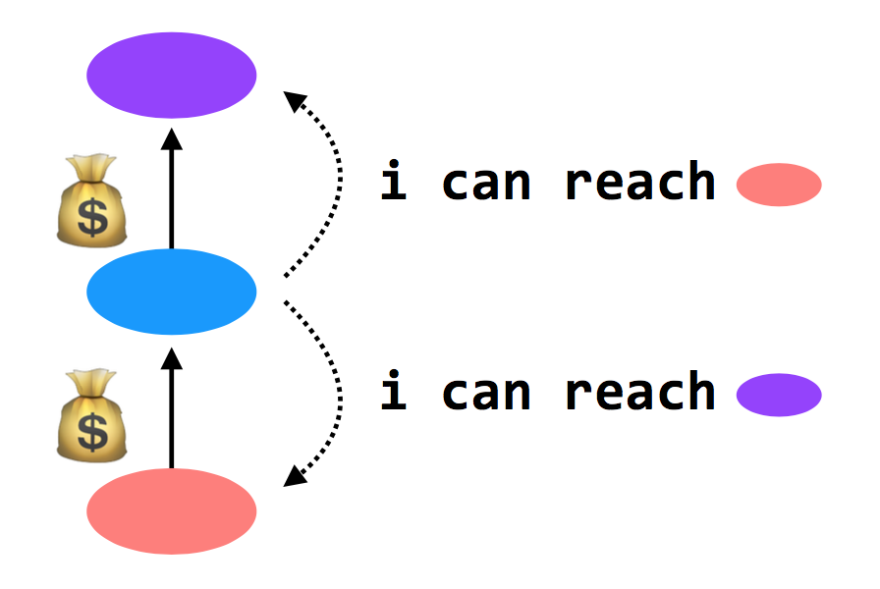
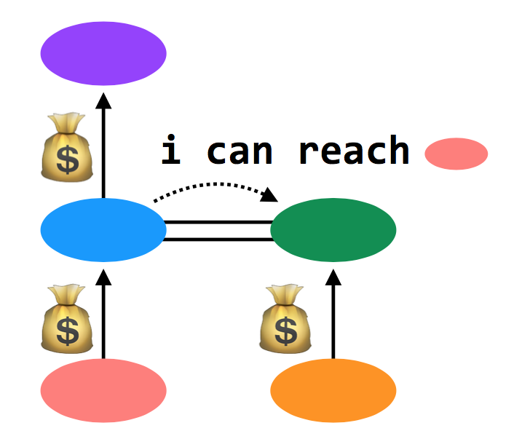
Customers and Peers
Customer/provider ("transit")
Providers tell everyone about themselves their customers
and tell their customers about everyone
Peers
Peers tell each other about their customers

Slide 144
Import Policies
Customer > peer > provider
And then a variety of other attributes when this rule isn't sufficient
Goal: make money

Slide 145
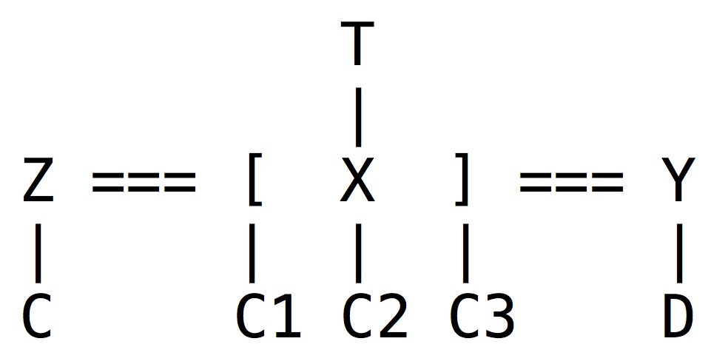

An Example
Z will tell X about C; C is a customer of Z, and X and Z are peers
X will tell Z and Y about C1, C2, and C3
Y will tell X about D
X will not tell Y about C; it makes no money to provide transit from Y to C
X doesn't tell Y about T; it would lose money to provide transit from Y to T
In example, Y appears disconnected from part of the network

Slide 146
An Example
BGP doesn't prevent this. In practice, it never happens. Because:
Almost every AS is a customer of someone else (i.e., Y would buy transit from someone)
Typically: small ASes buy Internet from Tier-3 ISPs, which buy Internet from Tier-2 ISPs, which buy Internet from Tier-1 ISPs. Tier-1's are huge; there are only a handful (10-15)
Additionally, all Tier-1 ISPs peer with one another. So each Tier-1 ISP can provide global connectivity

Slide 147
BGP in Distributed Routing
HELLO protocol
BGP sends KEEPALIVE messages to neighbors
Advertisements: Sent to neighbors
BGP runs on top of TCP
Doesn't have to do periodic advertisements to handle failure
Integration: via policies described above
Failures: routes can be explicitly withdrawn in BGP if fail
Routing loops avoided because BGP is path-vector

Slide 148
Problems with BGP
Does it scale?
Yes, it works on the Internet
But, BGP routing tables are getting big
Route instability due to misconfigurations or conflicting policies
One region can buy Internet from more than one ISP -> bigger table
Is it simple?
Yes to the protocol, but no to the implementation & operation
Is it secure?
No. A region can advertise a fake vector

Slide 149
2017: BGP hijacking! Traffic for Google, Apple, Facebook, Microsoft and other tech giants routed through Russia
http://securityaffairs.co/wordpress/66838/hacking/bgp-hijacking-russia.html

